Slide 1


Team 25
Francesco Paterna
Andrea Restelli
Andrea Sanchini
Specifica #4 – Verbalizzazione deli esami
Presentazione del progetto
Analisi delle tecnologie utilizzate
Commenti sulle scelte progettuali
Analisi delle funzionalità Aggiuntive

Slide 2
Pure HTML Version

Slide 3
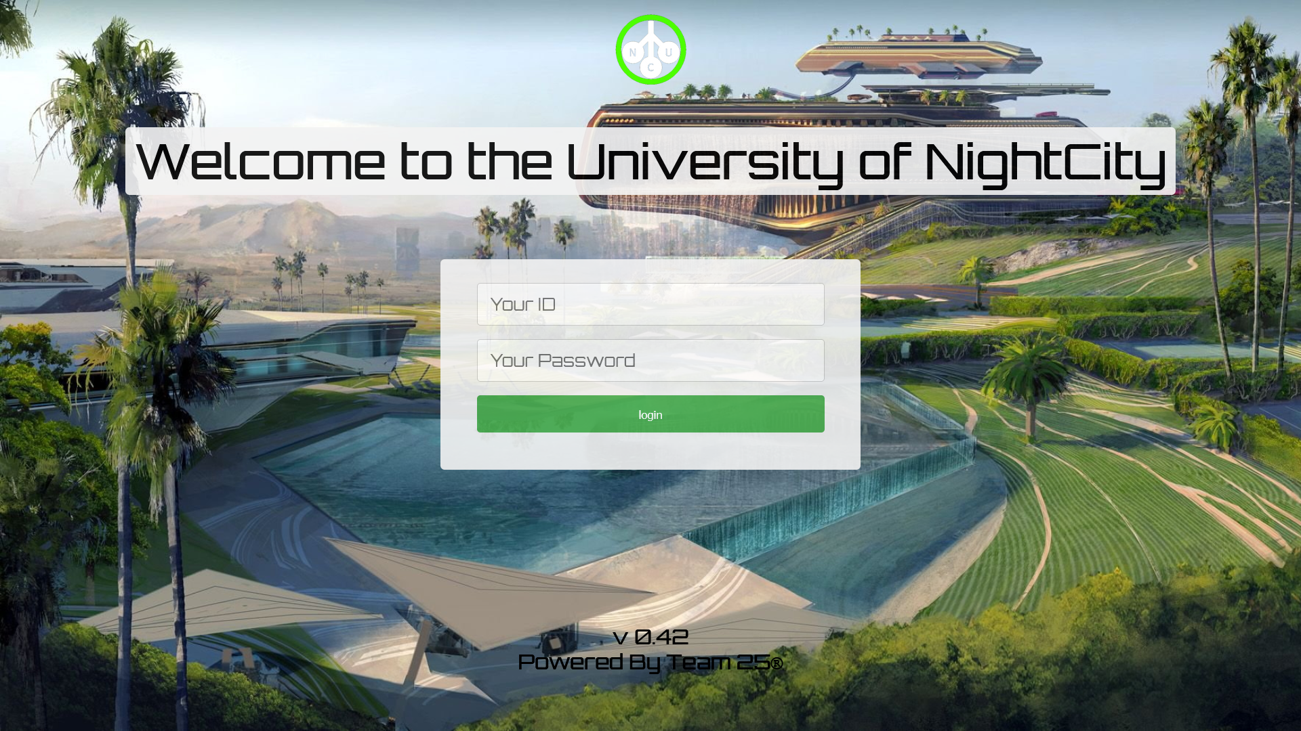
The Login Page
Students and professors have the same login page. Students have a 6 digits ID Example: 900123 Professors have a 5 digits ID Example: 10123 Once pressed the login button, the Servlet CheckLogin generate the digest of the password, and send a request to the Database.
We don’t store the password in Db, inside it you can find the digets [For this demo we chose SHA1]

Slide 4
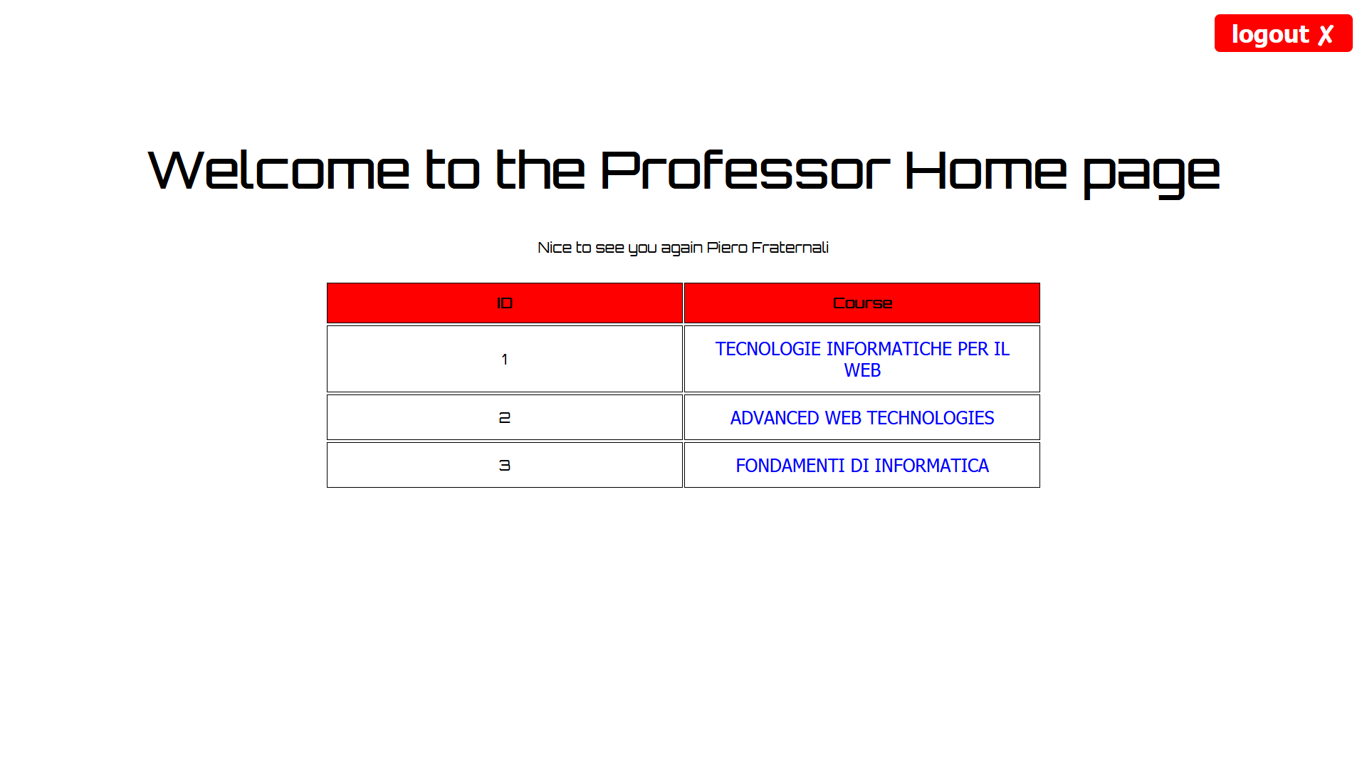
Professor’s Home Page
A simple table with all professor’s courses. The courses can be selected with buttons in the course column.
With CSS they are displayed as text seasoned with an underline effect

Slide 5
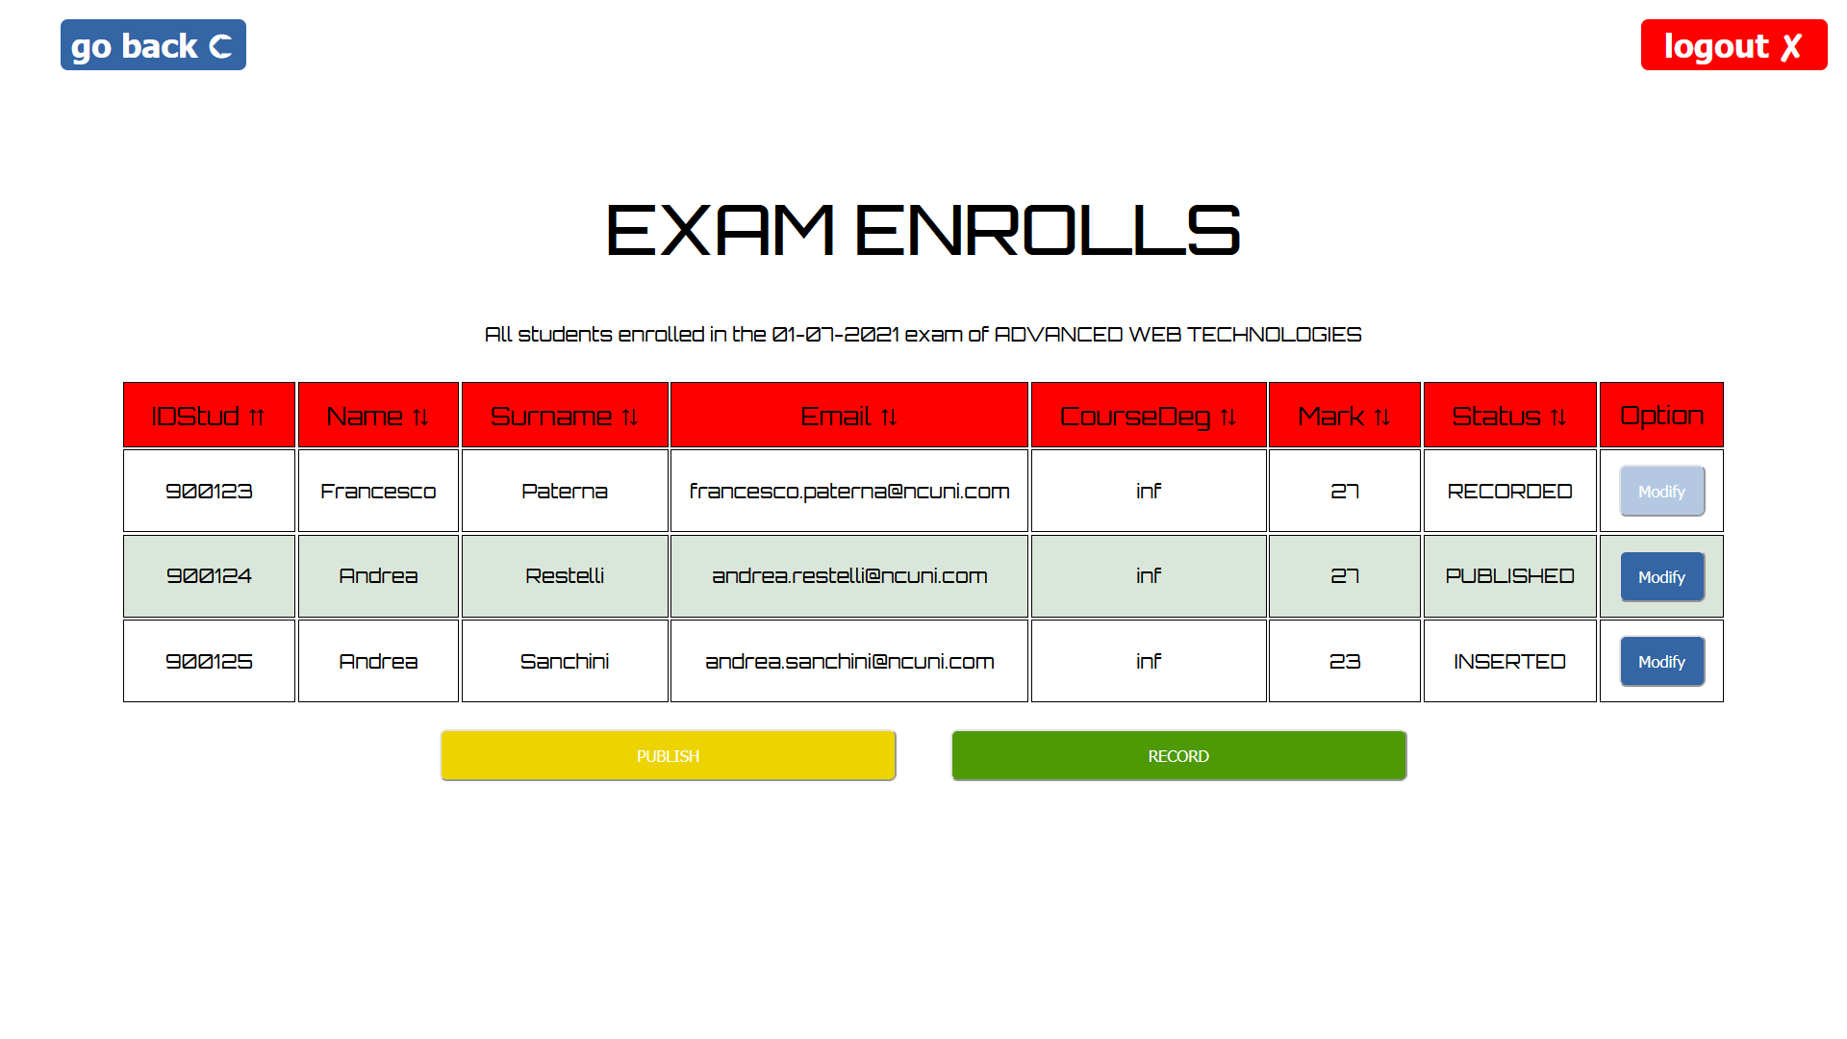
The Exam Enrolls Page
Thymeleaf at its highest level, all client-side controls are performed via dynamic buttons that change color and functionality.
The labels for selecting the sorts are also dynamic, and the arrows change according to the state.

Slide 6
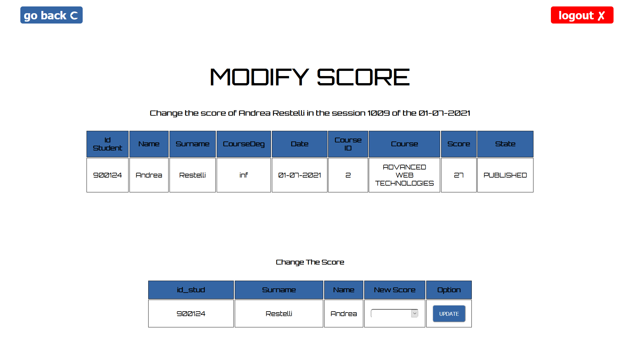
Modify Score Page
Thymeleaf at its highest level, all client-side controls are performed via dynamic buttons that change color and functionality.
The labels for selecting the sorts are also dynamic, and the arrows change according to the state.

Slide 7
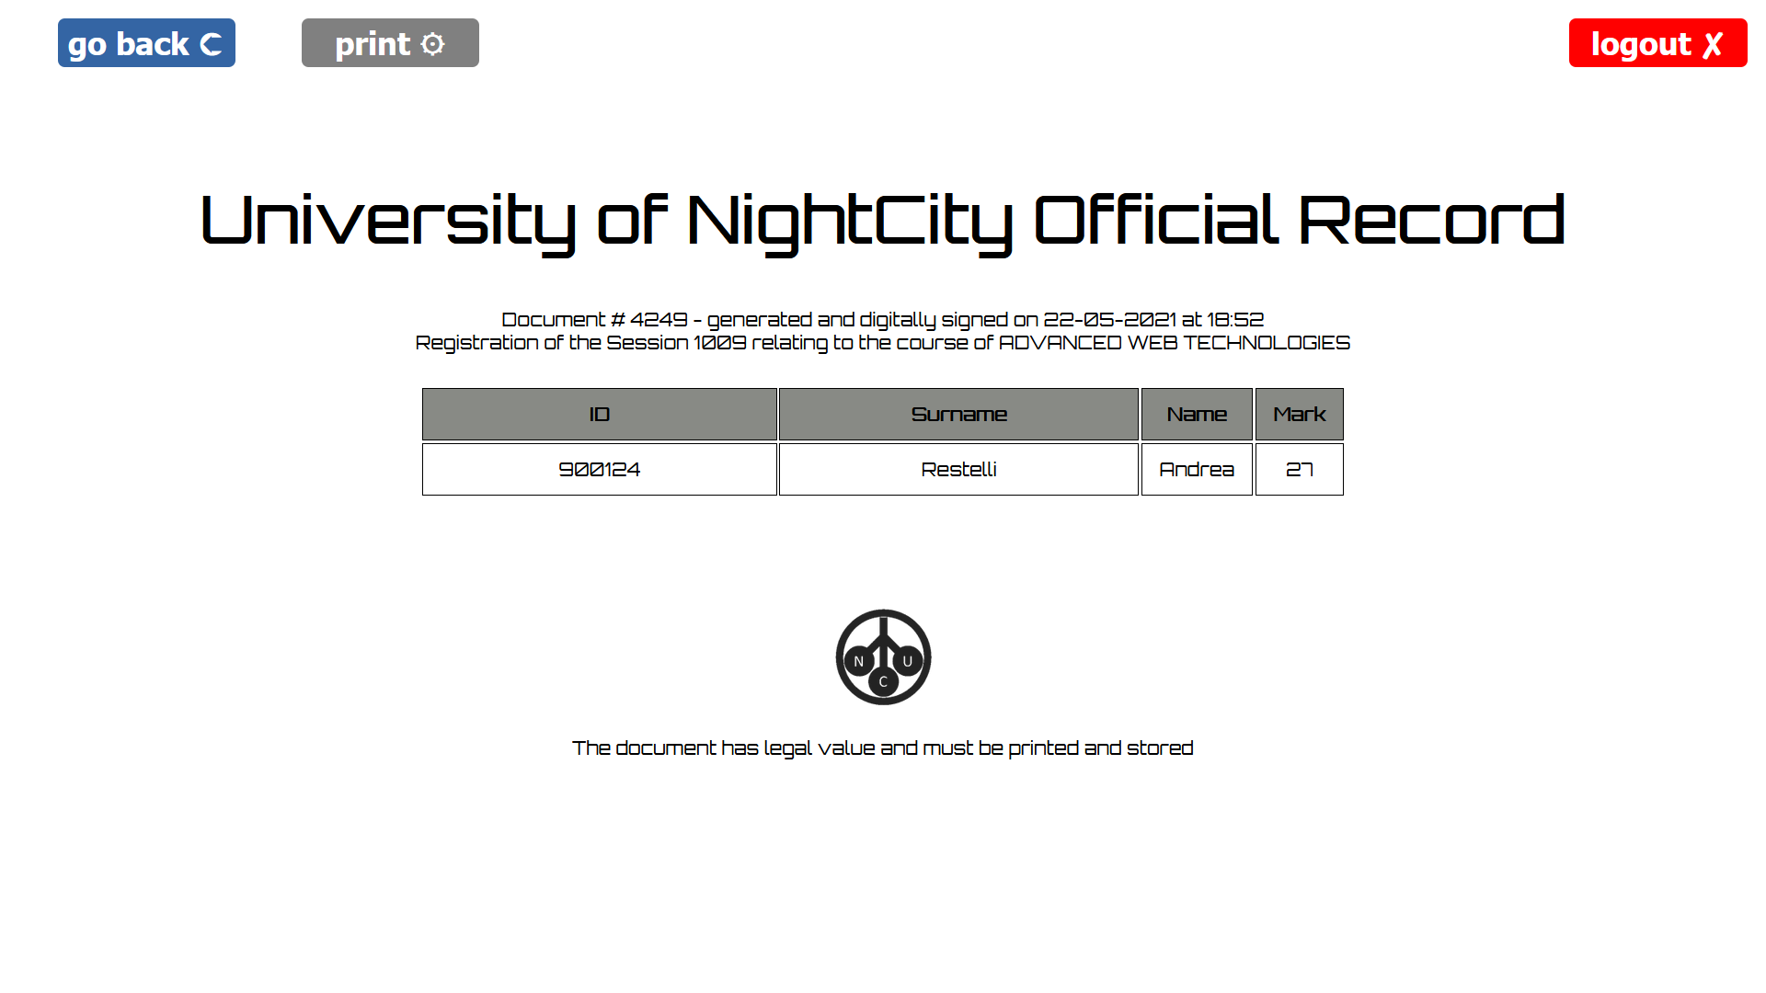
Record Page

Slide 8
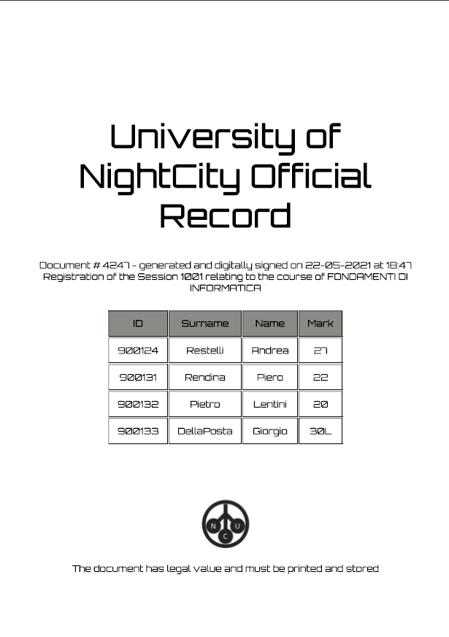
Record in PDF

Slide 9
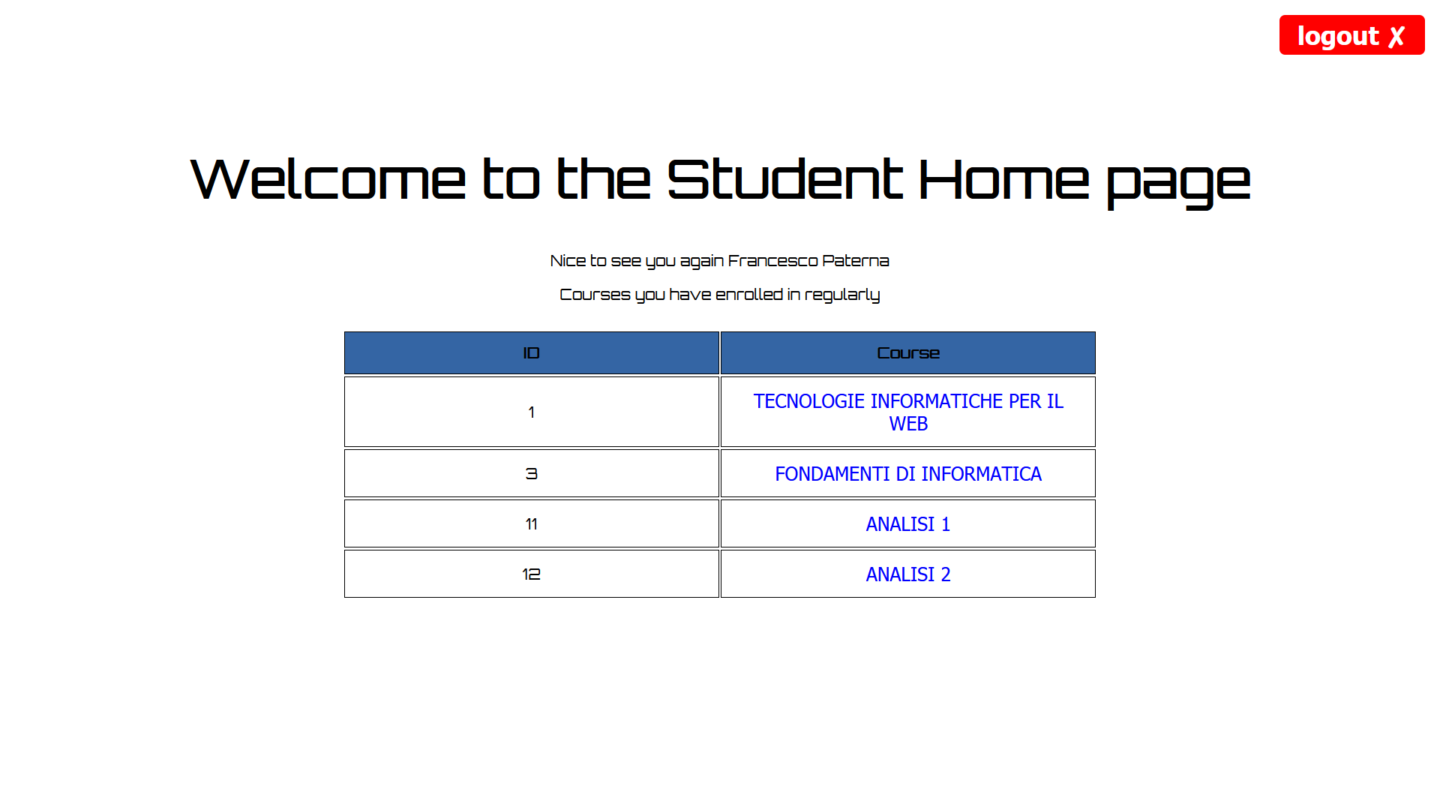
Student’s Home Page

Slide 10
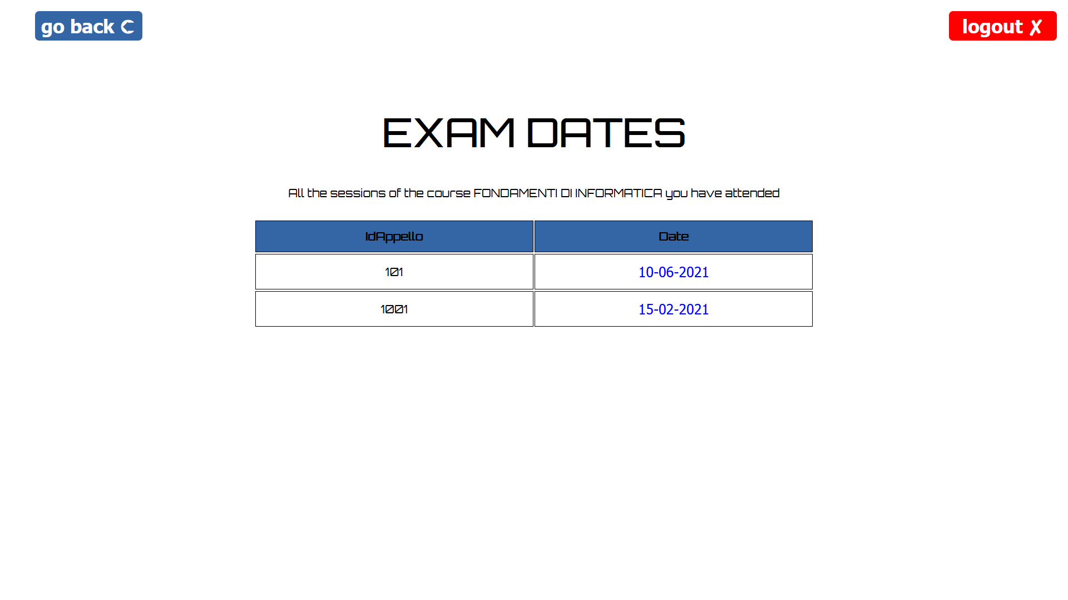
Student’s Exam Dates Page

Slide 11
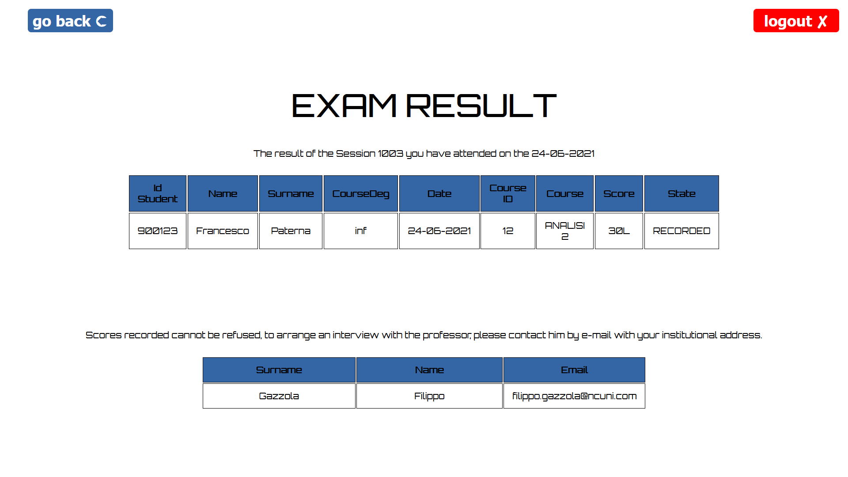
Exam Result Page

Slide 12
Javascript Version

